Slide 1
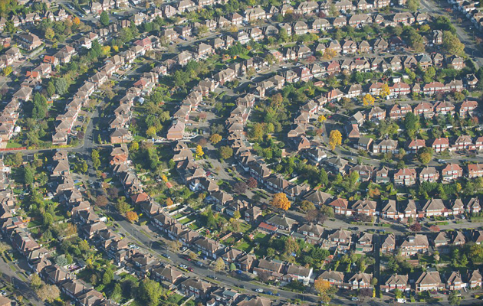
Predicting the best Borough in outer London for a food/drink business

Slide 2
INTRODUCTION
London is the capital and largest city of England and the United Kingdom. The city stands on the River Thames in the south-east of England, at the head of its 50-mile (80 km) estuary leading to the North Sea. London has been a major settlement for two millennia.
London is an international center of business, finance, arts, and culture, and is recognized as one of the most multicultural and cosmopolitan cities in the world. This means that the market is highly competitive meaning that the cost of doing business is one of the highest.
Data that might contribute to determining the best outer borough in London might include the Boroughs outside the city of London and their population, this type of businesses around them, and the lowest rent possible. This project aims to predict which outer Borough is the most suitable for opening of such type of business.
Obviously, everyone from an individual to a small or big company would be very interested in an accurate prediction of the best venue to make a profit of such business.

Slide 3
DATA ACQUISITION AND CLEANING
Most of the preferable data such as Boroughs of outter London with their coordinates, rent data, and venues data can be found online in Wikipedia (https://en.wikipedia.org/wiki/List_of_London_boroughs') and in the 4Square API.
Data were downloaded and scraped in one table. However, there was a problem because Wikipedia provide us with some information that weren't needed for our analysis such as Borough council, political situation, and the inner Boroughs of London. These data were deleted, and we only kept those that mattered to us such as Name, Area, Population, Coordinates, and Rent.
Through the explore function in 4SQuare we get a dataset of venues, from which we request the specific venues we take interest in.

Slide 4
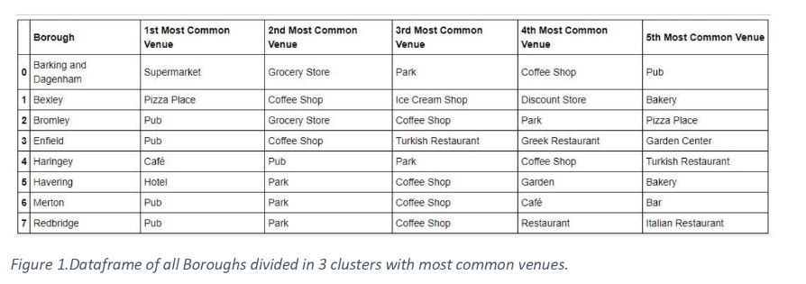
DATA ACQUISITION AND CLEANING

Slide 5
EXPLORATORY DATA ANALYSIS
First, we got the necessary information on London Boroughs, dropping the extras, that would not be needed for the analysis. Then we renamed the columns, making the dataset better on the eyes. Because of extra notes in the Wiki page, we only renamed some of the Boroughs.
Due to the staggering difference in rent price, as well as the number of venues in London, we filtered the data to have only the Outer boroughs going forward. We edited the coordinates, found the Boroughs with the lowest rent, counted the venues and found the most popular Boroughs.

Slide 6
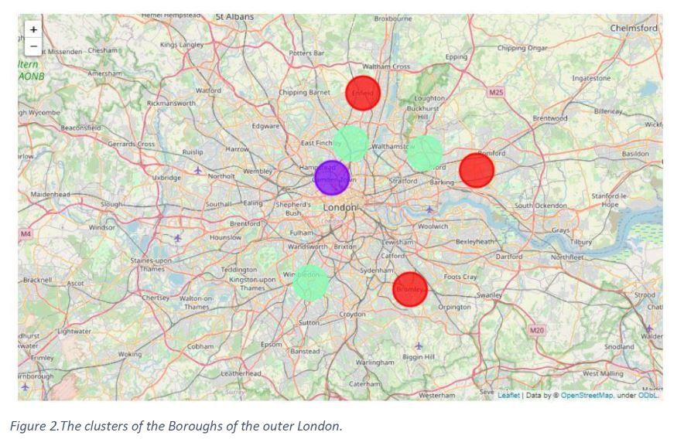
EXPLORATORY DATA ANALYSIS
Clustering
Once the Boroughs are selected, we cluster them to analyze their similarities and differences and we can find the advantages or disadvantages of each Borough selected.

Slide 7
RESULTS
In the first cluster which includes Barking and Dagenham, Bromley, and Enfield we see that the highest rent is in Bromley, while the other two Boroughs share the same price of rent. The lowest in popularity type of venue is Pizza Place for Bromley, Garden Center for Enfield (which is not similar with the type of business we are interested in), and Pub for Barking and Dagenham.
In the second cluster which includes Bexley, and Havering we see that the highest rent is in Bexley. The lowest in popularity type of venue is Bakery for both Boroughs.
In the third cluster which includes Haringey, Merton, and Redbridge we see that the highest rent is in Merton, while the lowest is in Haringey. The lowest in popularity type of venue is Turkish restaurant for Haringey, Bar for Merton, and Italian Restaurant for Redbridge.

Slide 8
DISCUSSION
Taking into consideration the population, the max rent, and the least common venue of these 3 clusters, we came into the conclusion that Enfield, Havering, and Haringey are the best places to open a food/drink business. Although a vast variety of information are lacking or cannot be retrieved at that moment, our data analysis provided a slight insight for a more profitable business move.

Slide 9
CONCLUSION
In conclusion, in this analysis I used some of the most common libraries to clear and manipulate data, and the 4square API to extract info about different types of venues in the outer London. By clustering the desirable Boroughs, I managed to conclude about the most suitable areas to open a food/drink business. Of course, due to lack of certain data, further future analysis is needed.

